Slide 1



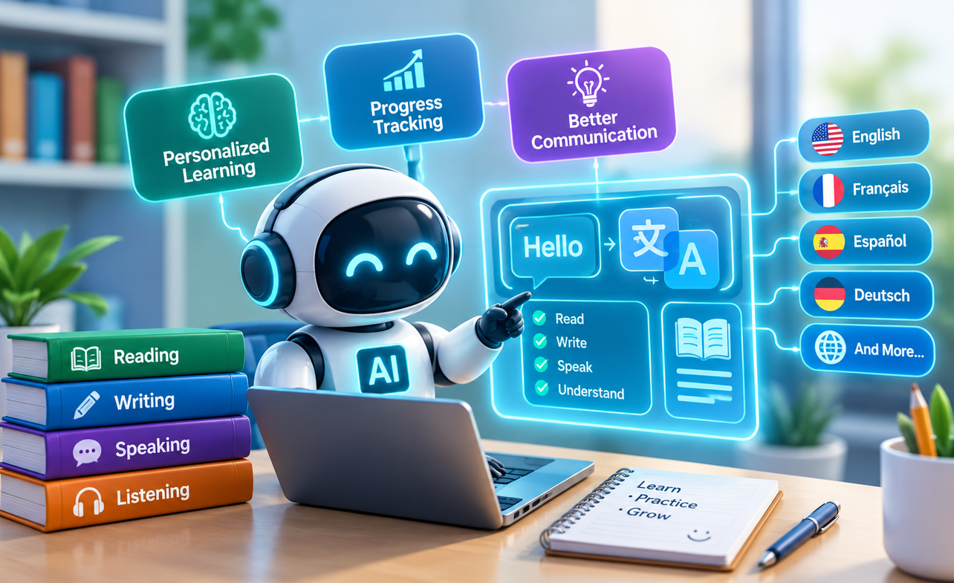



AI-ASSISTED DATA ANALYSIS
MODULE 8 · AI-ASSISTED DATA ANALYSIS
Machine Learning
for Literacy
Topic 2 of 3

Slide 2



RETRIEVAL PRACTICE
Before we go further, name these
90 SEC
Answer out loud or on paper - no notes. 90 seconds.
What does a trend-based forecast assume about the future, and what can it never see from only three months of data?
1
What does it mean to "stress-test" a forecast, and why did two reasonable methods giving different answers count as useful, not as a failure?
2
Name one thing SwiftRoute's Q3 file can tell you directly, just by looking at it, without needing any kind of model.
3
Notes:
1.7.2013
‹#›

Slide 3
"Can we just use AI to predict that?"
SwiftRoute's operations meeting keeps producing the same kind of request: predict which deliveries will fail, predict how long a delivery will take, group similar customers together. Someone always adds, "can we just use AI for that?"
Every
morning
The honest answer depends on which request is being asked. They are three different kinds of problem, and none of them can be built without a data scientist.
before the riders leave,
she opens one screen
What Adaeze's team can do today is recognise which is which, describe each accurately, and know when to say "that needs a data scientist."
Three different questions get asked as if they're one question. They are not the same problem.
Notes:
1.7.2013
‹#›

Slide 4
By the end of this topic, you can
1
2
3
4
Explain
Explain
Identify
Describe
supervised learning, classification and regression in plain language, each with a SwiftRoute example.
clustering and unsupervised learning in plain language, and how it differs from having a right answer to check against.
which of the three fits a given business problem, just from how the question is phrased.
the difference between an analyst's work and a data scientist's, and when to hand a question across that line.
Notes:
1.7.2013
‹#›

Slide 5
01
PART ONE
Supervised learning: classification and regression
What "supervised" actually means: learning from known right answers
Classification: predicting a category
Regression: predicting a number
5
Notes:
CONTENT: Section marker for Part One. Names the defining feature of supervised learning up front - it learns from historical examples where the right answer is already known - before splitting into its two forms.
WHAT TO SAY: "Part one: supervised learning. Three things. What 'supervised' actually means - learning from a pile of past examples where we already know the right answer. Classification, which predicts a category. And regression, which predicts a number. Same underlying idea, two different kinds of output."
DELIVERY CUE: Brief, forward-leaning.
TIMING: 30-45 seconds.
5

Slide 6
"Supervised" means: we already know the right answers
A supervised model learns from historical examples where the outcome is already recorded. SwiftRoute's Q3 file already has 3,600 deliveries where the outcome is known: each one is marked Delivered, Failed, Returned or In Transit, and each one has a real recorded duration. A supervised model studies that history and learns the pattern between the inputs, distance, route, time of day, and the known outcome, so it can estimate the outcome for a new delivery whose result is not yet known. The word "supervised" refers to that known-answer history, not to a person watching the model work.
No known answers in the history, no supervised learning. That single condition is worth checking before the word gets used in a meeting.
Notes:
1.7.2013
‹#›

Slide 7
Classification predicts a category. Regression predicts a number.
CLASSIFICATION
REGRESSION
• The answer is one of a fixed set of categories.
• SwiftRoute example: will this delivery end up Delivered, Failed, Returned, or still In Transit at day's end?
• "Predict which" and "predict whether" are the giveaway phrasings.
• Q3 reality check: 2,541 of 3,600 deliveries were Delivered, 340 Failed - a real, if imperfect, pattern to learn from.
• The answer is a number on a continuous scale, not a category.
• SwiftRoute example: how many minutes will this delivery take, given its distance and route?
• "Predict how much" and "predict how long" are the giveaway phrasings.
• Q3 reality check: real durations ranged from 8 to 189 minutes across the quarter - the kind of spread regression is built to estimate.
Same underlying method, supervised learning. The only real difference is the shape of the answer: a category, or a number.
Notes:
1.7.2013
‹#›

Slide 8
02
PART TWO
Unsupervised learning: clustering
What changes when there is no known right answer to learn from
Clustering: grouping similar things together
A real, ungraded grouping of SwiftRoute's customers
8
Notes:
CONTENT: Section marker for Part Two, moving from supervised methods (known answers) to unsupervised (no known answers). Sets up the defining contrast with Part One before naming clustering specifically.
WHAT TO SAY: "Part two, and this is where the ground shifts. Everything in part one needed a known right answer to learn from. Clustering has no such thing. We'll look at what changes when there's no answer key, what clustering actually does instead, and a real, ungraded grouping of SwiftRoute's own customers."
DELIVERY CUE: Brief.
TIMING: 30-45 seconds.
8

Slide 9
Clustering finds groups. Nobody tells it what the groups are.
Unsupervised learning has no known right answer to check against, which is the opposite condition from classification and regression. Clustering looks for items that are naturally similar to each other and groups them, without anyone specifying in advance what the groups should be or how many there should be. There is no accuracy score to compute, because there is no known correct grouping to compare against. The output is judged by whether the groups make business sense, not by whether they match a predetermined answer.
You cannot grade a clustering the way you grade a classification. There is no answer key to grade it against.
Notes:
1.7.2013
‹#›

Slide 10
A real grouping of SwiftRoute's Q3 customers
1. COUNT ORDERS PER CUSTOMER
2. LOOK FOR NATURAL BREAKS
3. NAME THE GROUPS
4. JUDGE BY USEFULNESS
SwiftRoute's Q3 file has 1,193 distinct customers placing 3,600 orders, averaging 3.0 orders each. But that average hides real structure: 214 customers ordered exactly once, most customers cluster around 2 to 4 orders, and a small handful, including one customer on 12 orders, are far more frequent than the rest. That is clustering by eye: three natural groups, one-time, occasional and frequent, found with nothing more than counting and looking.
WORTH NOTICING
No model was built here. A proper clustering tool would find groups like this automatically, and could use more variables at once, but the underlying idea, natural groups with no predefined labels, is exactly the same.
Notes:
1.7.2013
‹#›

Slide 11
03
PART THREE
Where the analyst's job ends
What an analyst can do with this literacy, without building a model
What genuinely needs a data scientist, and how to ask for it
Your turn: sort SwiftRoute's real requests into the three buckets
11
Notes:
CONTENT: Section marker for Part Three, moving from concepts to the practical boundary question: what can an analyst with this literacy actually do unassisted, versus what has to be hedged off to a data scientist, and how to make that hand-off a specific, useful request rather than a vague one.
WHAT TO SAY: "Part three, and this is the practical payoff. What can you, as an analyst, actually do with today's vocabulary, with no model-building involved? What genuinely needs a data scientist, and how do you ask for it properly rather than just saying 'can someone build me an AI for this'? Then it's your turn to sort SwiftRoute's real open requests into the three buckets."
DELIVERY CUE: Brief.
TIMING: 30-45 seconds.
11

Slide 12
An analyst describes the past. A data scientist predicts the future at scale.
An analyst's core work, cleaning, verifying, summarising and reporting on data that already exists, covers an enormous amount of real business value without ever building a model: Topic 8.1's whole pipeline and Topic 8.2's forecast were both done this way. A data scientist's distinct skill is building, training and validating a model that generalises beyond the historical data it was built from, then maintaining it as new data arrives. The line is not about intelligence or seniority. It is about a specific technical skill set: model-building and validation, which most analyst roles, including this one, are not expected to have.
"I can tell you what happened, and forecast a simple trend by hand. Building a model that predicts new cases needs a data scientist." is a complete, honest sentence.
Notes:
1.7.2013
‹#›

Slide 13
Sort SwiftRoute's real requests
10 MIN
YOUR TURN
THE TASK
Four requests: (1) which deliveries will fail this week, (2) how much fuel Route LAG-07 uses next month, (3) which riders behave most alike, (4) how many deliveries happened in September. Name each: classification, regression, clustering, or no model needed.
SELF-CHECK
(1) classification. (2) regression. (3) clustering. (4) no model needed, it's counting - an analyst task, like Topic 8.1's pipeline. Only (1)-(3) would need a data scientist to actually build.
Compare your answers with a neighbour before the recap - disagreement on the wording is fine, disagreement on which bucket is worth discussing.
Notes:
1.7.2013
‹#›

Slide 14

Topic recap
Supervised learning needs a history with known right answers already recorded in it.
Up Next:
Automating repetitive
analyst tasks
Classification predicts a category. Regression predicts a number. Same method, different shape of answer.
Clustering has no known right answer, so its groups are judged by business usefulness, not an accuracy score.
An analyst can describe the past and forecast a simple trend with zero models - that alone covers real business value.
Building a model that generalises to new cases is a distinct skill: know when to hand a question to a data scientist, and how to ask for it.
Next: automating the repetitive parts of an analyst's own job - so the value you already deliver survives a data refresh.
Notes:
1.7.2013
‹#›

Slide 15
Where this goes next
TOPIC 8.4
PIPELINE LAB
CAPSTONE PROPOSAL
Automating repetitive analyst tasks: identifying what can be automated, and building a simple automation that survives a data refresh.
When the lab throws up a genuinely model-shaped question, name it correctly using today's vocabulary rather than guessing at a fix.
If your capstone idea needs a model to generalise to new cases, say so plainly in your proposal - that is a strength, not a gap.
Notes:
1.7.2013
‹#›

